Slide 1

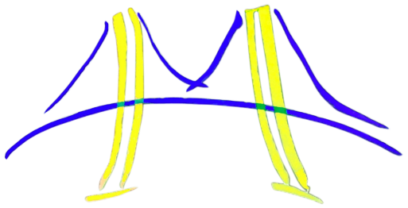
Object Tracking with Particle Filter
Connor Braa, Nathaniel Mailoa,
Kevin Mohyi, Praveen Puvvaddi
Final Project Presentation
CS194-15 Fall 2013:
Engineering Parallel Software
University of California, Berkeley

Slide 2
Outline
Problem/application
Algorithm
High-level software architecture of implementation of algorithm
Parallelizing the Software Architecture
Strategy: Concurrent Algorithm Strategy used
Implementation: Implementation Strategy Patterns used
Execution: Parallel Execution Patterns used
Optimization: Optimization Patterns used
Final results
Lessons Learned

Slide 3
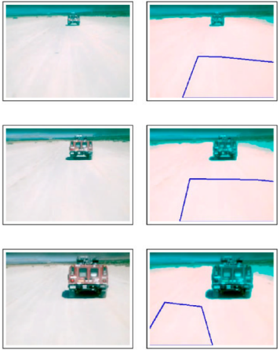
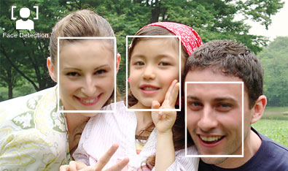
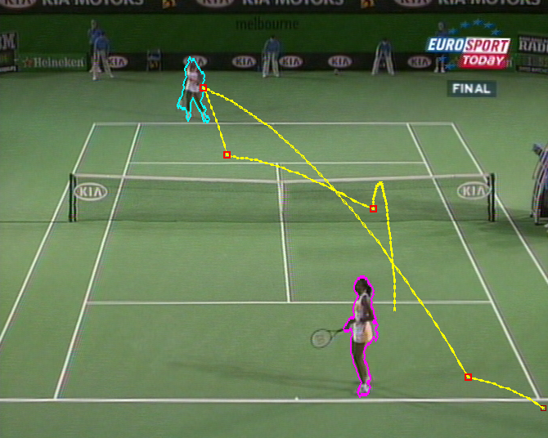
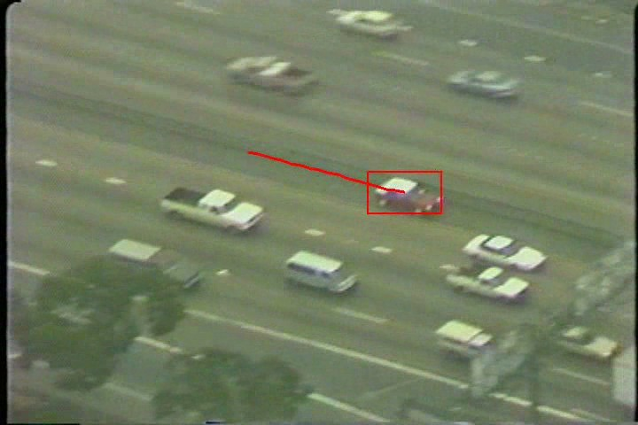
Motivation: Computer Vision
Many computer vision tasks require some form of object tracking
Face detection for pocket cameras
Traffic camera footage
Sports live coverage, training
Autonomous cars
Sony
Stanford University
People Image Analysis Consortium
University of Surrey

Slide 4
Problem: Object Tracking
Excellent object tracking algorithms need huge computational power
Need a simple yet highly parallelizable framework that could be run on common hardware (i.e. CPUs)
Sony
Stanford University
People Image Analysis Consortium
University of Surrey

Slide 5
Outline
Problem/application
Algorithm
High-level software architecture of implementation of algorithm
Parallelizing the Software Architecture
Strategy: Concurrent Algorithm Strategy used
Implementation: Implementation Strategy Patterns used
Execution: Parallel Execution Patterns used
Optimization: Optimization Patterns used
Final results
Lessons Learned

Slide 6
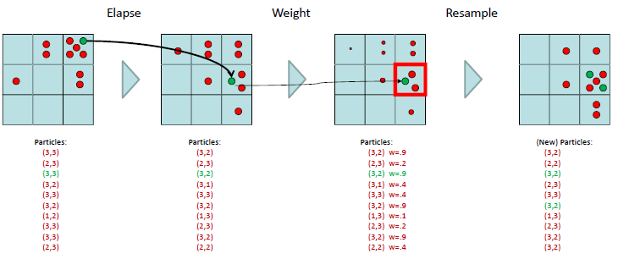
Particle Filter
CS188 Dan Klein & Peter Abbeel
Velocity data (dx, dy) is also used in elapse stage
Particles are kept as 4-tuples <x,y,dx,dy>
Problem: random number generator

Slide 7
Bhattacharyya Distance
UNEDITED

Slide 8
Outline
Problem/application
Algorithm
High-level software architecture of implementation of algorithm
Parallelizing the Software Architecture
Strategy: Concurrent Algorithm Strategy used
Implementation: Implementation Strategy Patterns used
Execution: Parallel Execution Patterns used
Optimization: Optimization Patterns used
Final results
Lessons Learned

Slide 9
Software Architecture
Initialize Particles
Read Input Video/Frame
Convert to sensor reading (feature extraction)
Increment Timestep (Transition Function)
Incorporate Evidence
(Weight Adjustment)
Put more detail on converting input to prob distr here??
Particle Redistribution
Draw Output

Slide 10
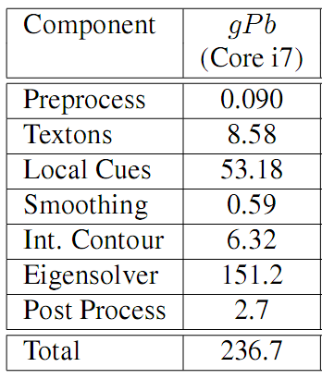
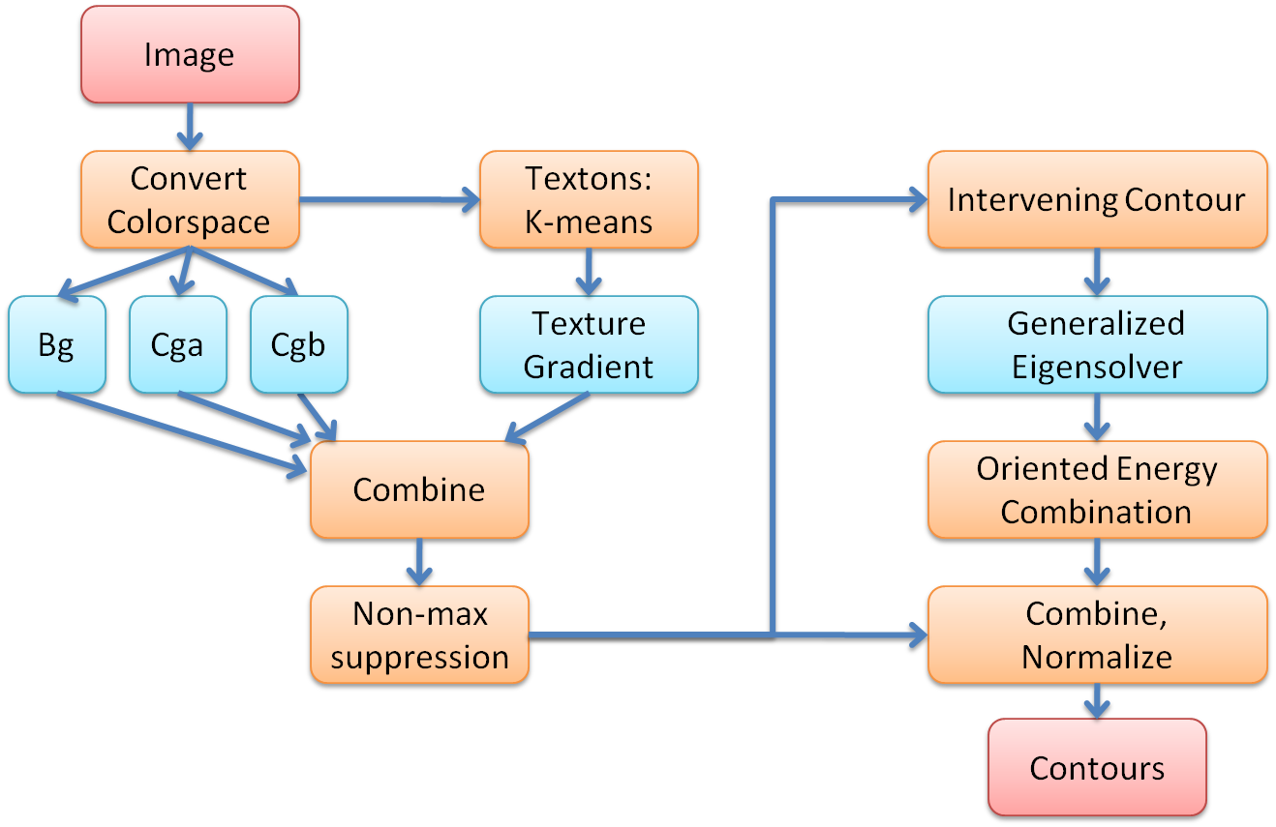
Profile of the Execution Time
UNEDITED

Slide 11
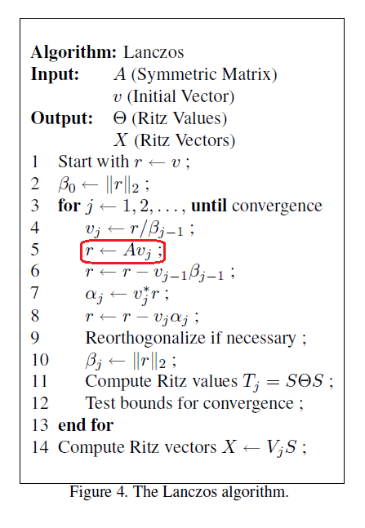
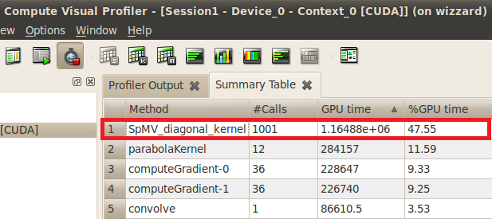
Applying Lanczos Algorithm
Since W is a symmetric sparse matrix, the Lanczos Algorithm can be used to approximate the eigenvalues and eigenvectors
Repeatedly multiplying A*v_{j} is computationally expensive, since the size of matrix, A, is the square of the number of pixels in the image
UNEDITED
Source: Berkeley Par-Lab

Slide 12
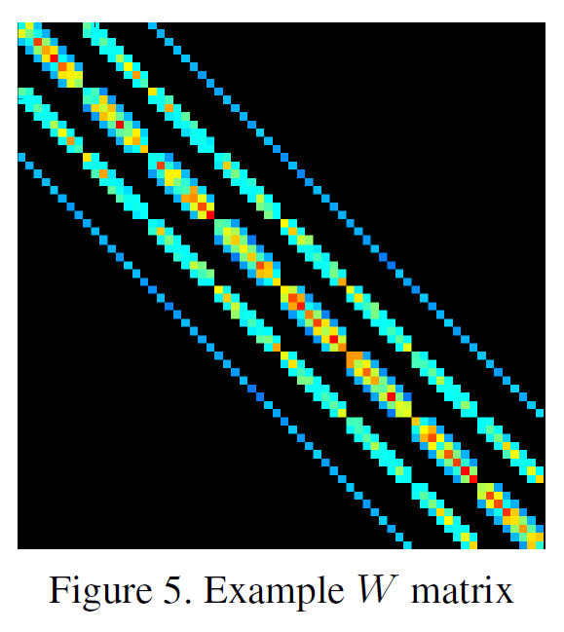
Key Kernel
Sparse matrix vector multiplication
Computational pattern
Sparse linear algebra
UNEDITED

Slide 13
Outline
Problem/application
Algorithm
High-level software architecture of implementation of algorithm
Parallelizing the Software Architecture
Strategy: Concurrent Algorithm Strategy used
Implementation: Implementation Strategy Patterns used
Execution: Parallel Execution Patterns used
Optimization: Optimization Patterns used
Final results
Lessons Learned

Slide 14
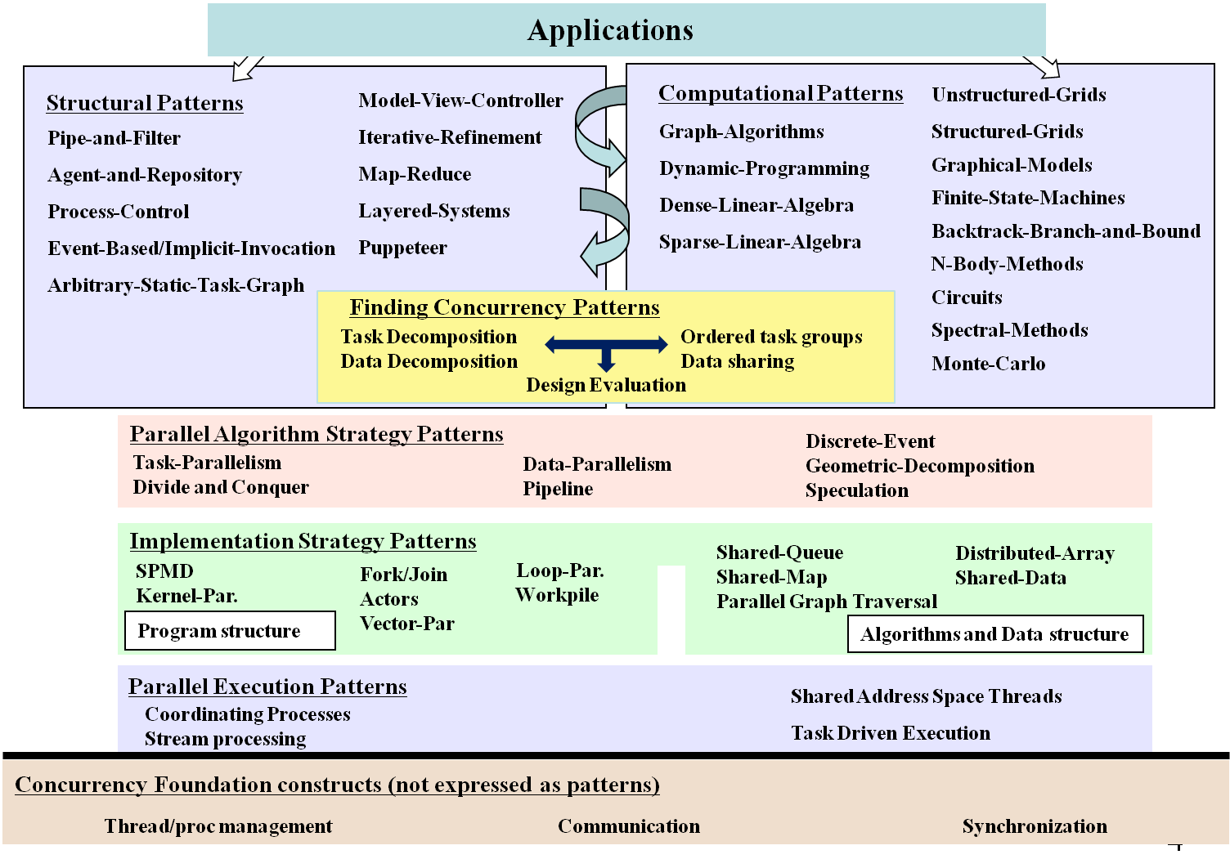
PLPP/OPL 2012
UNEDITED

Slide 15
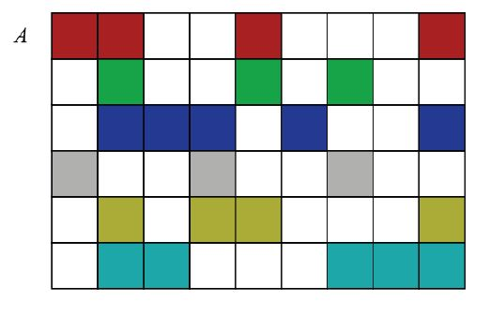
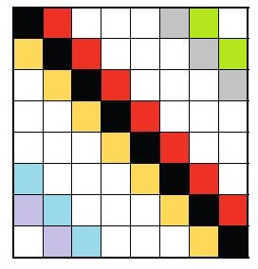
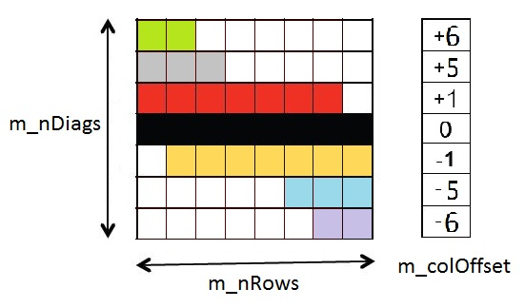
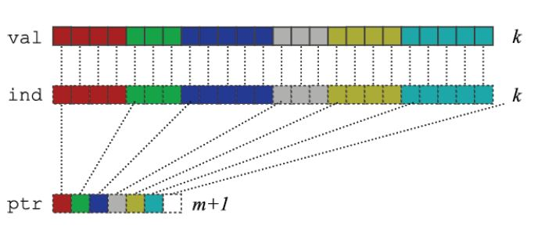
Lessons from the Sparse Linear Algebra Pattern
Many ways of representing the matrix
CSR Representation
Diagonal Representation
UNEDITED

Slide 16
Analysis of the Possible Solutions
The matrix has many dense diagonals
The memory footprint of the diagonal representation is less
Choose the diagonal representation
UNEDITED

Slide 17
Software Architecture of the DIA Format - I
For each Diagonal
For each Row
Compute column index
Multiply-add
Dia 2, Vec b, c
Dia n, Vec b, c
...
Matrix A and Vector b, c
Dia 1, Vec b, c
UNEDITED
*
=
*
=
A
b
c
A
b
c
Map reduce? No
Agent and repository? Yes
because vector c is shared among agents

Slide 18
Software Architecture of the DIA Format - II
For each Row
For each Diagonal
Compute column index
Multiply-add
Row 1, Vec b
Row 2, Vec b
Row n, Vec b
...
UNEDITED
Vec c1
Vec c2
Vec cn
*
=
A
b
c
Map reduce? Yes
Agent and repository? Yes

Slide 19
Analysis
Software Architecture – I
Vector c is shared among agents
Has dependency, need atomic updates
Software Architecture – II
Can be represented using the Map-Reduce Pattern
Does not have dependency
Software Architecture – II should be a better solution
UNEDITED
*
=
A
b
c

Slide 20
PLPP/OPL 2012
UNEDITED

Slide 21
Finding Concurrency
Each matrix row contributes to a single element in vector c
Data decomposition over Rows
Row 1, Vec b
Row 2, Vec b
Row n, Vec b
...
UNEDITED
Vec c1
Vec c2
Vec cn
*
=
A
b
c
Map reduce? Yes
Agent and repository? Yes

Slide 22
Parallelizing the Dia SpMV
UNEDITED

Slide 23
Parallelizing the Dia SpMV on CPU
UNEDITED

Slide 24
Parallelizing the Dia SpMV on CPU Using OpenMP
UNEDITED

Slide 25
OpenMP Diagonal SpMV
void DiagMatrix::SpMV(float* vecIn, float* vecOut)
{
#pragma omp parallel for
for (int i = 0; i < m_nRows; i++)
{
float sum = 0.0;
float * rowPtr = i * m_nDiags + m_diags;
for (int j = 0; j < m_nDiags; j++)
{
int col = m_colOffset[j] + i;
if (col >= 0 and col < m_nRows)
sum += rowPtr[j] * vecIn[col];
}
vecOut[i] = sum;
}
}
Decomposing data over rows using the loop parallelism pattern
UNEDITED

Slide 26
Other Optimization – Loop Unrolling
void DiagMatrix::SpMV(float* vecIn, float* vecOut)
{
int biggestOffset = 0;
for (int i = 0; i < m_nDiags; i++)
if (m_colOffset[i] > biggestOffset)
biggestOffset = m_colOffset[i];
if (m_nRows <= 2*biggestOffset)
{
#pragma omp parallel for
for (int i = 0; i < m_nRows; i++)
{
float sum = 0.0;
int col;
float * rowPtr = i * m_nDiags + m_diags;
col = m_colOffset[0] + i;
if (col >= 0 and col < m_nRows)
sum += rowPtr[0] * vecIn[col];
col = m_colOffset[1] + i;
if (col >= 0 and col < m_nRows)
sum += rowPtr[1] * vecIn[col];
col = m_colOffset[2] + i;
if (col >= 0 and col < m_nRows)
sum += rowPtr[2] * vecIn[col];
col = m_colOffset[3] + i;
if (col >= 0 and col < m_nRows)
sum += rowPtr[3] * vecIn[col];
col = m_colOffset[4] + i;
if (col >= 0 and col < m_nRows)
sum += rowPtr[4] * vecIn[col];
col = m_colOffset[5] + i;
if (col >= 0 and col < m_nRows)
sum += rowPtr[5] * vecIn[col];
col = m_colOffset[6] + i;
if (col >= 0 and col < m_nRows)
sum += rowPtr[6] * vecIn[col];
col = m_colOffset[7] + i;
if (col >= 0 and col < m_nRows)
sum += rowPtr[7] * vecIn[col];
col = m_colOffset[8] + i;
if (col >= 0 and col < m_nRows)
sum += rowPtr[8] * vecIn[col];
col = m_colOffset[9] + i;
if (col >= 0 and col < m_nRows)
sum += rowPtr[9] * vecIn[col];
col = m_colOffset[10] + i;
if (col >= 0 and col < m_nRows)
sum += rowPtr[10] * vecIn[col];
col = m_colOffset[11] + i;
if (col >= 0 and col < m_nRows)
sum += rowPtr[11] * vecIn[col];
col = m_colOffset[12] + i;
if (col >= 0 and col < m_nRows)
sum += rowPtr[12] * vecIn[col];
col = m_colOffset[13] + i;
if (col >= 0 and col < m_nRows)
sum += rowPtr[13] * vecIn[col];
col = m_colOffset[14] + i;
if (col >= 0 and col < m_nRows)
sum += rowPtr[14] * vecIn[col];
col = m_colOffset[15] + i;
if (col >= 0 and col < m_nRows)
sum += rowPtr[15] * vecIn[col];
col = m_colOffset[16] + i;
if (col >= 0 and col < m_nRows)
sum += rowPtr[16] * vecIn[col];
col = m_colOffset[17] + i;
if (col >= 0 and col < m_nRows)
sum += rowPtr[17] * vecIn[col];
col = m_colOffset[18] + i;
if (col >= 0 and col < m_nRows)
sum += rowPtr[18] * vecIn[col];
col = m_colOffset[19] + i;
if (col >= 0 and col < m_nRows)
sum += rowPtr[19] * vecIn[col];
col = m_colOffset[20] + i;
if (col >= 0 and col < m_nRows)
sum += rowPtr[20] * vecIn[col];
col = m_colOffset[21] + i;
if (col >= 0 and col < m_nRows)
sum += rowPtr[21] * vecIn[col];
col = m_colOffset[22] + i;
if (col >= 0 and col < m_nRows)
sum += rowPtr[22] * vecIn[col];
col = m_colOffset[23] + i;
if (col >= 0 and col < m_nRows)
sum += rowPtr[23] * vecIn[col];
UNEDITED

Slide 27
Outline
Problem/application
Algorithm
High-level software architecture of implementation of algorithm
Parallelizing the Software Architecture
Strategy: Concurrent Algorithm Strategy used
Implementation: Implementation Strategy Patterns used
Execution: Parallel Execution Patterns used
Optimization: Optimization Patterns used
Final results
Lessons Learned

Slide 28
Experimental Results
Method | Runtime
Serial CSR | 21.5ms
OpenMP CSR | 4.4ms
Serial DIA Architecture I | 25.2ms
Serial DIA Architecture II | 22.4ms
OpenMP DIA Architecture II | 3ms
OpenMP DIA Architecture II Loop Unrolled | 2.4ms
UNEDITED

Slide 29
Theoretical Max Speedup with OpenMP
Running the stream benchmark with 8 threads on the lab machine:
-------------------------------------------------------------------------------- Function Rate (MB/s) Avg time Min time Max time Copy: 19477.2497 0.0017 0.0016 0.0018 Scale: 18890.6021 0.0019 0.0017 0.0033 Add: 19378.8230 0.0027 0.0025 0.0043 Triad: 20142.7306 0.0029 0.0024 0.0066 --------------------------------------------------------------------------------
Bandwidth achieved from SpMV = matrix read + input vector read + output vector write + column_offset read = 153600 * 81 * 4 + 153600 * 4 + 153600 * 4 + 81 * 4 = 50,995,524 bytes
Theoretical best running time = 50,995,524 / (19477.2497 * 10^6) = 2.62ms
Experimental results even better than theoretical results?
UNEDITED

Slide 30
Theoretical Max Speedup with OpenMP
Why could OpenMP implementation show more than P-X speedup with P processors? (for lab machine, P=8)
Caching effect: As we increase the number of threads, we are also increasing the amount of cache (and associated prefetchers) available, and therefore decreasing our bandwidth requirement.
On x86 CPUs, IIRC, each cache at every level has its own prefetcher, load-store queues, associative sets, etc. These aspects of the memory system can have as big an impact on performance as the size of the cache.
UNEDITED
Credit: Mark Murphy @ Par-Lab

Slide 31
Outline
Problem/application
Algorithm
High-level software architecture of implementation of algorithm
Parallelizing the Software Architecture
Strategy: Concurrent Algorithm Strategy used
Implementation: Implementation Strategy Patterns used
Execution: Parallel Execution Patterns used
Optimization: Optimization Patterns used
Final results
Lessons Learned

Slide 32
Conclusions
SpMV represents the dominant cost in many iterative methods for solving large-scale linear systems and eigenvalue problems.
The diagonal storage scheme (DIA) efficiently encodes matrices arising from the application of stencils to regular grids.
We implemented SpMV in DIA format in both CUDA and OpenMP.
On a 153600x153600 matrix, the OpenMP implementation is 9x faster after unrolling the loop. The CUDA implementation is 31x faster, after unrolling the loop and optimizing memory accesses to efficiently utilize Global DRAM, __shared__ memory, texture memory and constant memory.
On Damascene code, the SpMV kernel utilizes 45% memory bandwidth and has a texture hit rate of about 96%. The performance is slightly faster than that of stencilMVM implementation.
UNEDITED

